Slide 1
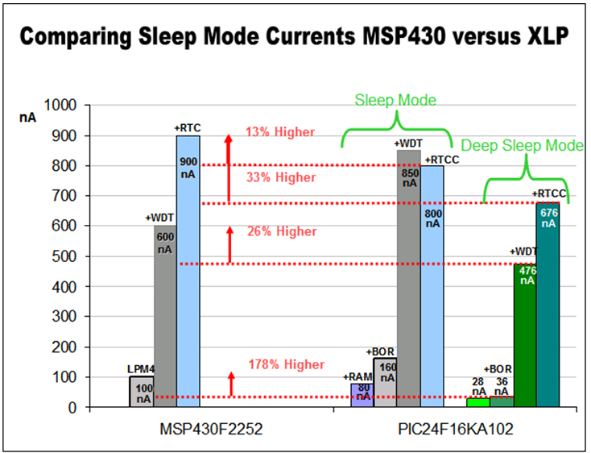
PIC To Replace MSP430 In Battery-powered Application

